Slide 1
Identifying Trivial Factors Correlated to Men’s NCAA D1 Basketball Outcomes
Zain Bharde, TAMU, zain.bharde@tamu.edu, Member
Michael Edwards-Sarver, TAMU, smestamu@tamu.edu, Member
John Mutammara, TAMU, johnmutammara@tamu.edu, Member
Austin Ngo, TAMU, austingo@tamu.edu, Member

Slide 2
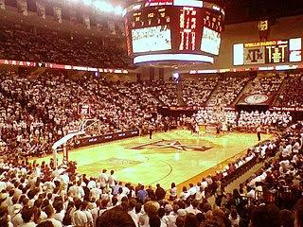
Abstract
When predicting who is going to win a basketball game, many look towards the clear factors such as shooting percentage, defensive formations, rebounding skill, etc. But what if there were different factors that impacted the chances a team has to win? Our team was wondering that exact same question and put it to the test. For our project we sought to discover such factors.
Notes:
john

Slide 3
Objectives
- Identifying trivial features with higher predictive power for NCAA D1 Men’s basketball game outcomes.
- Constructing a dataset consisting of both trivial and conventional predictive features related to a collection of past games.
- Assessing the predictive value of trivial features compared to conventional ones.
- Developing insights into the overlooked aspects that may influence game outcomes.
Notes:
austin

Slide 4
Identifying Trivial Features
We began with brainstorming and conducting research to choose factors that we thought could contribute to the outcome of a game and would be practical to collect. Maybe the temperature at a given game would affect the outcome, but it would be impractical to find the temperature at every time/location for 1000+ games. We found more general and identifiable factors like: stadium attendance, program budget, university enrollment, average team attendance, and venue capacity. The After choosing what we wanted to explore we could begin procuring data.
Notes:
austin

Slide 5
Constructing a Dataset
After identifying the trivial factors that we wanted to further investigate, we began our mission of constructing a dataset. To do this, we first conducted research to find a large library of past NCAA D1 Men's basketball games. This is important because it develops a baseline for our model to go off of. Without this historical data we would not be able to gauge the importance that each of these obscure factors may or may not have. Apart from that, we collected data for our trivial features such as stadium attendance at each game, basketball team expenses, total undergraduates, and more for each D1 school from varying sources. After gathering all these datasets, we utilized pandas to clean and merge them all into one large dataframe.
Notes:
zain

Slide 6
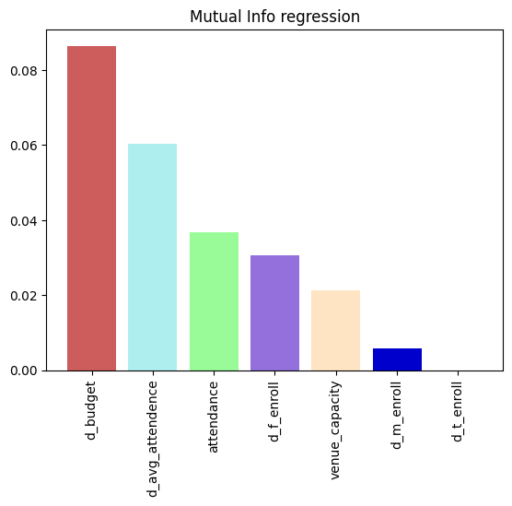
Method: mutual_info_regression
The first and simplest method was to utilize sklearn.mutual_info_regression which measures the dependency of output features for each input feature and is independent of the shape of correlation.
Notes:
michael

Slide 7
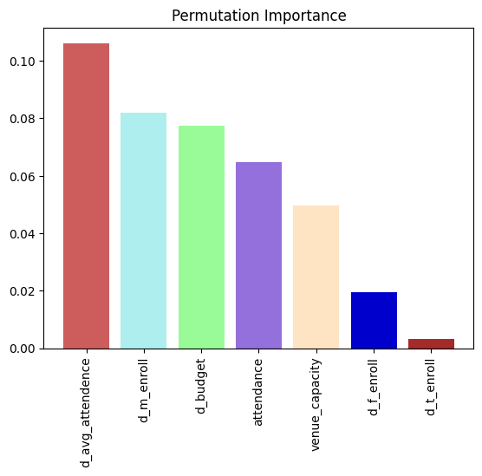
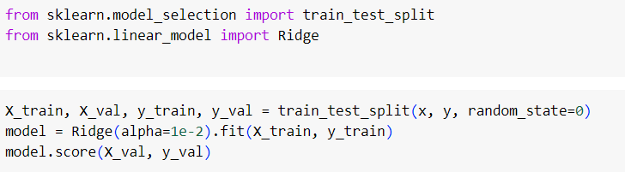
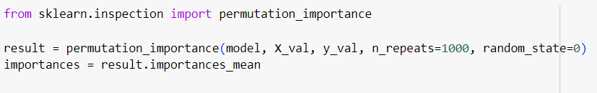
Method: permutation_importance
The next method involved creating a simple Ridge regression model and applying permutation_importance from sklearn, which shuffles values for each feature and assesses how much the accuracy of the model decreases.
Notes:
michael

Slide 8
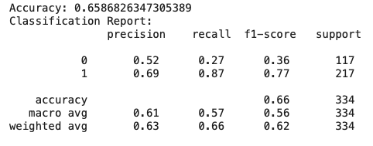
Method: Random Forest Classifier
We implemented a Random Forest classification model to draw correlations between the historical data and trivial factors. The model was evaluated for its ability to accurately predict the binary outcome of a game with wins and losses being denoted by 1 and 0 respectively. The Random Forest Classification model had 65.86% accuracy.
Notes:
zain

Slide 9
Observations
The outputs for the first two methods are surprising. Venue capacity and total enrollment are consistently unimportant while budget and average attendance are consistently of high importance. The achieved model accuracy of 65.89% with a Random Forest classifier indicates a moderate level of predictive power, considering the unconventional nature of the feature set utilized. From this we can conclude that trivial factors such as total enrollment and program budget should hold power in the process of predicting game outcomes. This is an impactful insight since sports prediction is a huge sector, and analysts are constantly searching for additional information to sway their prediction when two teams seems evenly matched.
Notes:
john

Slide 10
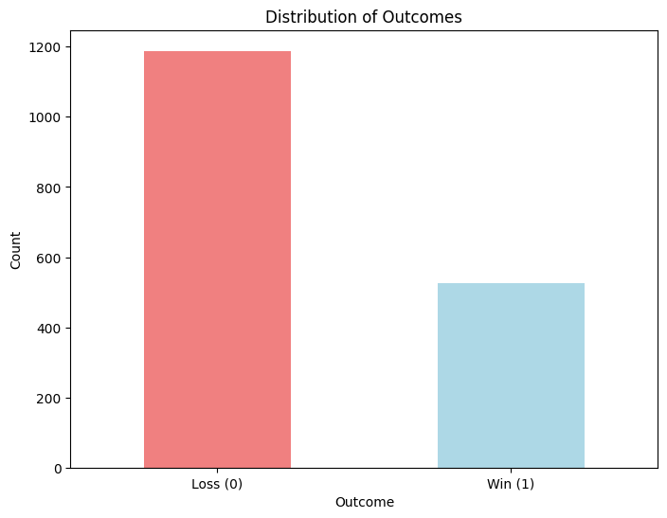
Limitations
While an accuracy rate of 65.86% is promising, it also displays signs of imperfections. There are a few factors that could have disrupted the learning process of our model. The first one is the class imbalance within our dataset. Our dataset contained substantially more home team losses than wins that led to our models learning process favoring the outcome of a home team losing. The scope of the dataset was also a limiting factor. Whether trivial or not there are numerous factors that contribute to the outcome of a basketball game, and the more that are included, the better the model will learn and, consequently, increase the accuracy of the dataset. There were also limits in our resources and some concessions to data relevance had to be made.
Notes:
zain

Slide 11
Future Work
Our work may serve as a framework for future repetitions of our analysis. There are many techniques and resources designed to determine the importance of features in their relation to an outcome. Future recreations could follow essentially the same steps we did, but with more features, more samples, and more accuracy. If enough features were processed, groundbreaking discoveries could be made. If a certain factor of a game is discovered to be more predictive than anyone was aware of, it could change the way teams play in the league.
Notes:
austin

Slide 12
References
Source for Dean Olivers “Four Factors of Basketball Success” https://aquicktimeout.com/dean-olivers-four-factors-for-basketball-success/
Source for basketball budget data(article): https://www.three-man-weave.com/3mw/college-basketball-budgets-2022
Government education database to get money spent on basketball program and university enrollment data: https://ope.ed.gov/athletics/#/
NCAA Men's D1 attendance records: http://fs.ncaa.org/Docs/stats/m_basketball_RB/2024/Attend.pdf
sklearn Mutual regression classifier documentation: https://scikit-learn.org/stable/modules/generated/sklearn.feature_selection.mutual_info_regression.html
sklearn RandomForestClassifier documentation: https://scikit-learn.org/stable/modules/generated/sklearn.ensemble.RandomForestClassifier.html
Source for general non-trivial team data of all D1 teams: https://stats.ncaa.org/rankings?sport_code=MBB
Dataset of NCAA games: https://console.cloud.google.com/bigquery?p=bigquery-public-data&d=ncaa_basketball&page=dataset&project=ecen-project-418021&ws=!1m9!1m4!4m3!1sbigquery-public-data!2sncaa_basketball!3smbb_games_sr!1m3!3m2!1sbigquery-public-data!2sncaa_basketball&authuser=1

